Slide 1
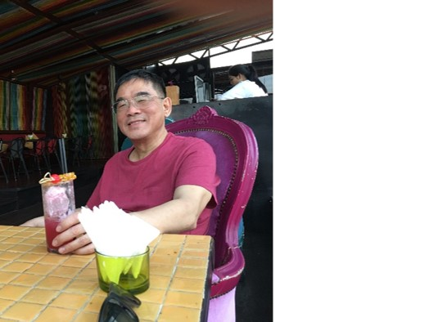
Database Lecture 8
Relational Design
Purpose and Atomicity
Addendum
Dr. Jefferson Fong
Reference 7.1

Slide 2
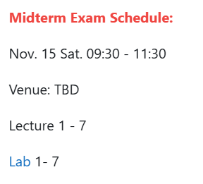
Announcements
Anyone who cannot attend at that time must apply for official excuse form in order to take the make-up test.
Closed book, no notes or any electronic devices allowed.
Bring a pen (or two) and your UIC or government issued photo ID card.

Slide 3
Announcement
Project
All requirements are in iSpace under “Project – Problem description”
  Check the Timeline section on when tasks are due.
ER diagram is due on Sunday 23 Nov 11:59 pm
Static Webpages (html files) are due Sunday 30 Nov 11:59 pm

Slide 4
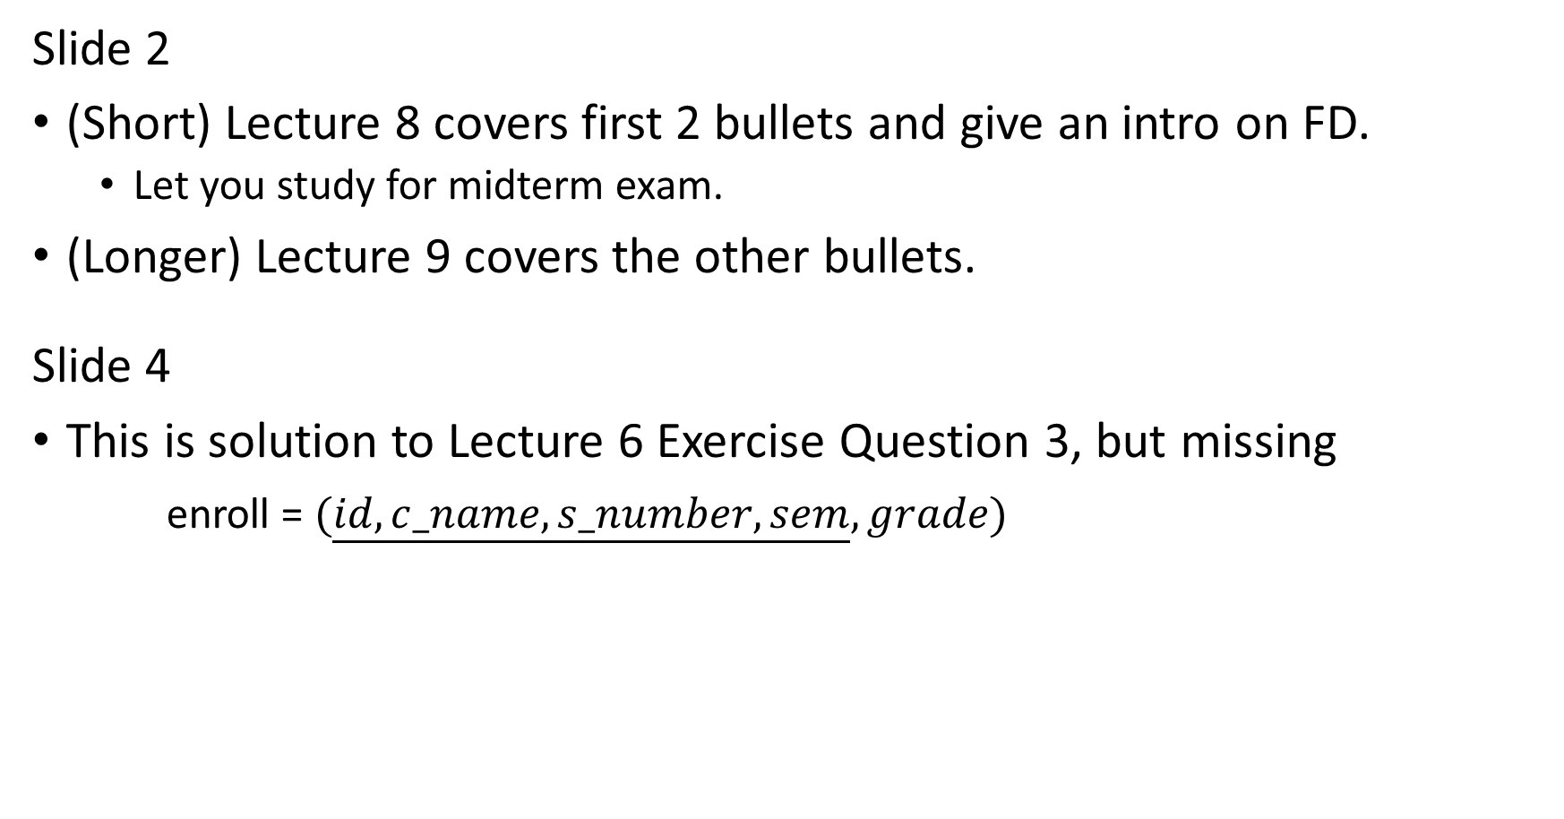
Slide 2
(Short) Lecture 8 covers first 2 bullets and give an intro on FD.
  Let you study for midterm exam.
(Longer) Lecture 9 covers the other bullets.
Slide 4
This is solution to Lecture 6 Exercise Question 3, but missing
enroll = $(\underline{id,c_name,s_number,sem},grade)$

Slide 5
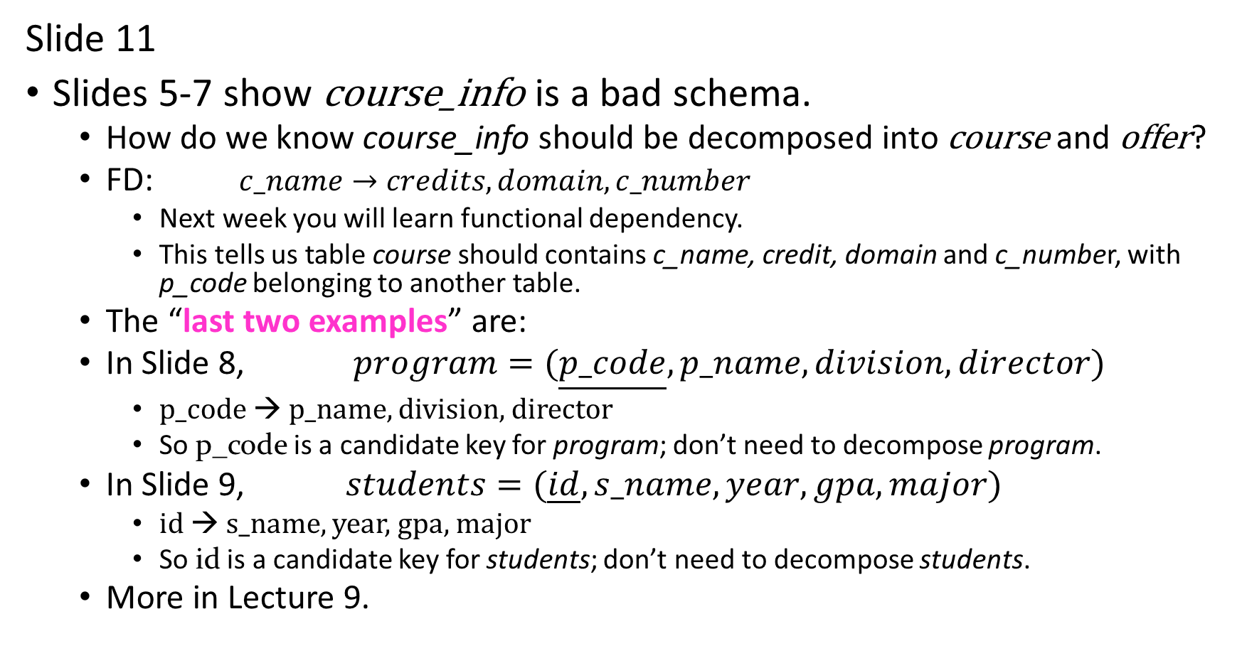
Slide 11
Slides 5-7 show course_info is a bad schema.
  How do we know course_info should be decomposed into course and offer?
  FD: $c_name→credits,domain,c_number$
    Next week you will learn functional dependency.
    This tells us table course should contains c_name, credit, domain and c_number, with p_code belonging to another table.
  The “last two examples” are:
  In Slide 8, $program=(\underline{p_code},p_name,division,director)$
    p_code → p_name, division, director
    So p_code is a candidate key for program; don’t need to decompose program.
  In Slide 9, $students=(\underline{id},s_name,year,gpa,major)$
    id → s_name, year, gpa, major
    So id is a candidate key for students; don’t need to decompose students.
  More in Lecture 9.

Slide 6
Slide 13
In ancient Greeks philosophy, an atom is the smallest indivisible unit of matter.
Slide 14
If data is not atomic, need another Java or Python program to extract “CS” from “CS0012”.
Bad idea to require application programs to extract info rather than using SQL.
“Lab07b addendum.pptx” – correction to Lab07.
Intro to Lab 8.

Slide 7
Lab 7b – Correct errors from last lab.
Lab 8 NULL and Subquery

